Slide 1
WEATHER MONITORING SYSTEM: A DATA ACQUISITION SYSTEM
The Weather Monitoring System uses sensors and devices that measure the weather conditions that are analyzed and displayed.
Shreyansh Bhalotia 13BIT0169

Slide 2
Problem Statement

Slide 3
The system shall provide automatic monitoring of various weather conditions.
Specifically, it must measure:
• Wind speed and direction
• Temperature
• Barometric pressure
• Humidity
The system shall also provide the following derived measurements:
• Wind chill
• Dew point temperature
• Temperature trend
• Barometric pressure trend

Slide 4
The system shall have a means of determining the current time and date, so that it can report the highest and lowest values of any of the four primary measurements during the previous 24 hour period.
The system shall have a display that continuously indicates all eight primary and derived measurements, as well as the current time and date. Through the use of a keypad, the user may direct the system to display the 24-hour high or low value of any one primary measurement, together with the time of the reported value.
The system shall allow the user to calibrate its sensors against known values, and to set the current time and date…”

Slide 5
Hardware Assumptions

Slide 6
In addition, Booch also makes some basic hardware assumptions:
• We will use a single-board computer (SBC) with a 486-class processor. • Time and date are supplied by an on-board clock, accessible via memory-mapped I/O.
• Temperature, barometric pressure, and humidity are measure by on-board circuits (with remote sensors), also accessible via memory-mapped I/O.
• Wind direction and speed are measure from a boom encompassing a wind vane (capable of sensing wind from any of 16 directions) and cups (which advance a counter for each revolution).

Slide 7
• User input is provided through an off-the-shelf telephone keypad, managed by an on-board circuit supplying audible feedback for each key press. Last user input is accessible via memory mapped I/O.
• The display is an off-the-shelf LCD graphic device, managed by an on-board circuit capable of processing a simple set of graphics primitives, including messages for drawing lines and arcs, filling regions, and displaying text.
• An on-board timer interrupts the computer every 1/60 second.
The kind of hardware is chosen to simplify the software development process and to alleviate much of the low-level coding that would otherwise be required.

Slide 8
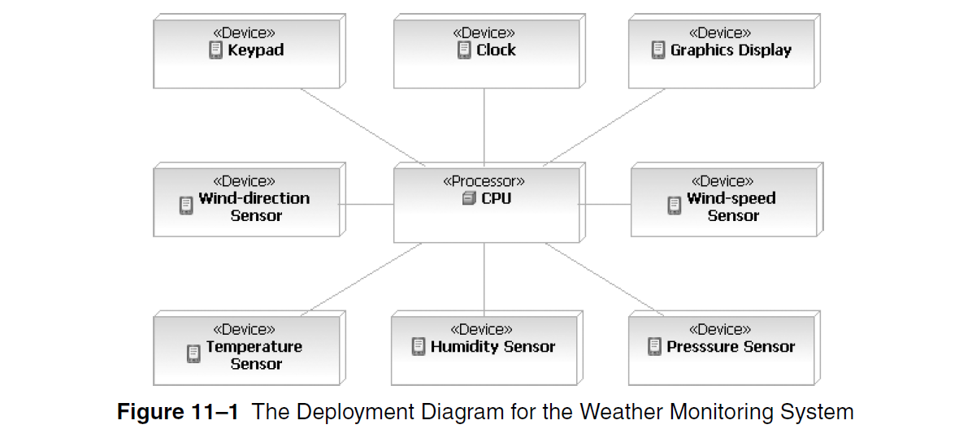

Slide 9

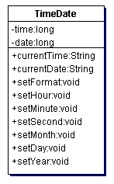
Time-Date Class
This class is responsible for keeping the track of date and time

Slide 10
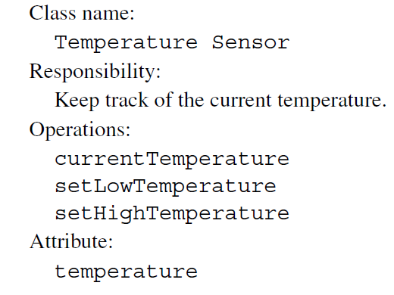

Slide 11
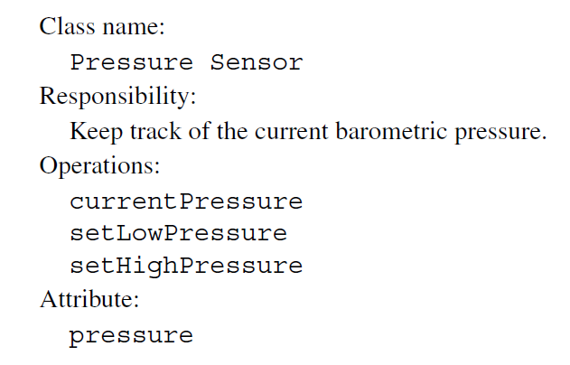

Slide 12
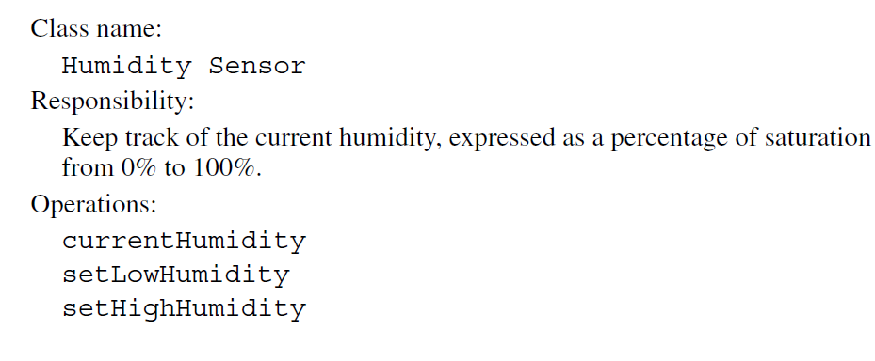

Slide 13
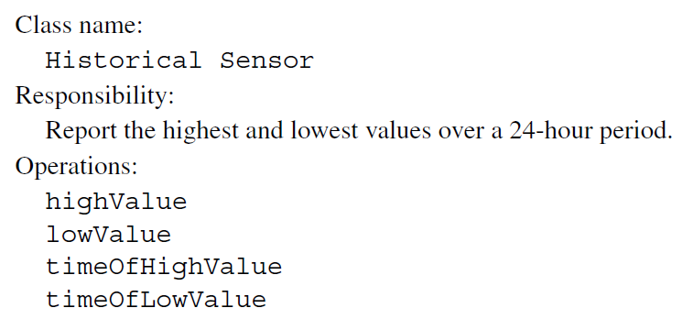

Slide 14
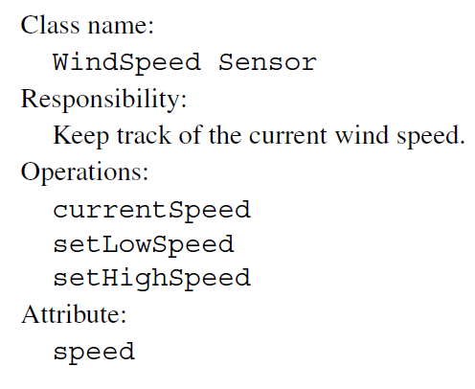

Slide 15
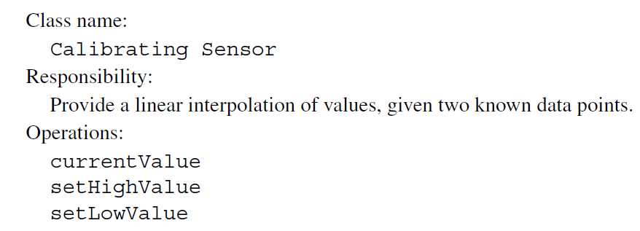

Slide 16
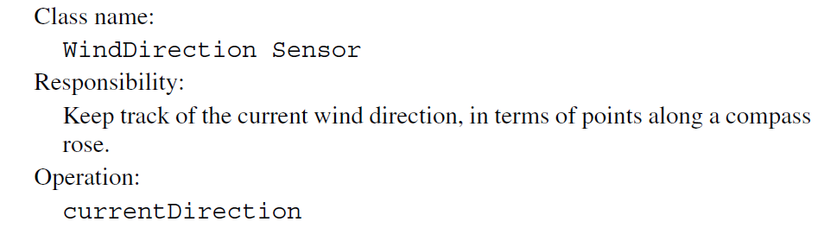

Slide 17
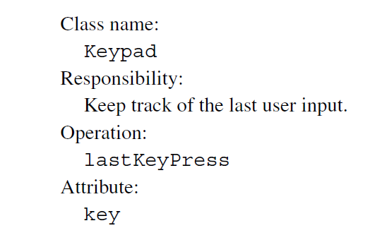

Slide 18
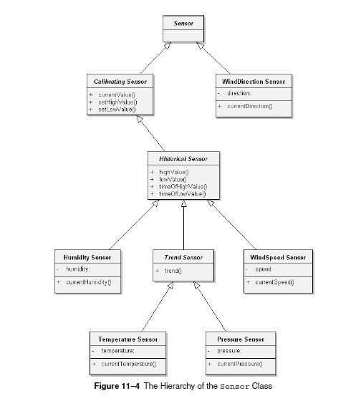

Slide 19
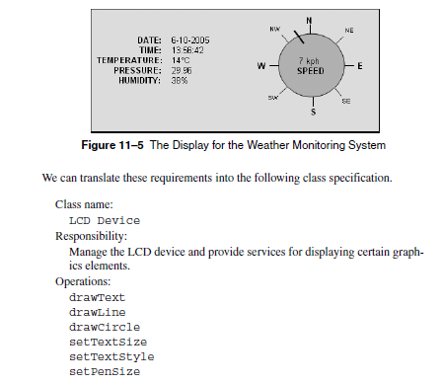

Slide 20
Now, there will be use case diagrams and sequence diagrams for the system that we will have to make. So, we start by identifying the primary use cases.

Slide 21
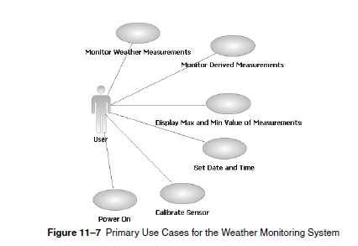
TO BE CONTINUED…

